Slide 1

Introduction to Big data
Online Shopping Intention Prediction
Sahar Faraht

Slide 2
Agenda Style
01
Introduction
02
Univariate analysis
03
Bivariate Analysis
04
Predictive models

Slide 3
Introduction

Slide 4
The importance of Big Data analysis for Online Shopping
Recent estimates from the global e-commerce chamber that in 2020, global ecommerce growth rates hit 25.7%. This represents the largest year-over-year increase between 2019 and 2025 and can be attributed to the coronavirus pandemic. In the United States alone, ecommerce sales are expected to surpass $740 billion by 2023
As advantageous it is to customers it come with grate and huge responsibilities to retailers, who needs to understand the consumption pattern. Due to the huge amount of data generated by the consumption history on the e-shops, using big data techniques to study the pattern is becoming crucial.

Slide 5

Information about the Dataset
Online Shoppers Purchasing Intention Dataset consists of feature vectors belonging to 12,330 sessions.
The dataset was formed so that each session would belong to a different user in a 1-year period to avoid any tendency to a specific campaign, special day, user profile, or period.
The original source of the data is the UCI machine learning Repository
Source paper: Sakar, C.O., Polat, S.O., Katircioglu, M. et al. Neural Comput & Applic (2018).

Slide 6
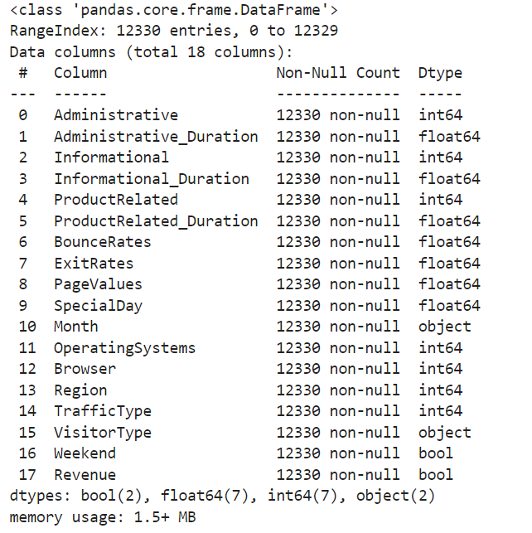
Data description
The columns match description of the data set
Some numeric (int, float) columns, string columns and Boolean columns
Preliminary check reveals no obvious missing data (column value counts match row counts)
A few categorical columns need to be converted to str

Slide 7
Numerical values descriptive statistics
Attribute | Min | Max | Mean | SD
Administrative | 0.00 | 27.000 | 2.338878 | 3.330436
Administrative_Duration | 0.0 | 3398.75 | 81.646331 | 177.491845
Informational | 0.00 | 24.000 | 0.508726 | 1.275617
Informational_Duration | 0.00 | 2549.3750 | 34.825454 | 141.424807
ProductRelated | 0.00 | 705.000 | 32.045637 | 44.593649
ProductRelated_Duration | 0.00 | 63973.522230 | 1206.982457 | 1919.601400
BounceRates | 0.00 | 0.2000 | 0.020370 | 0.045255
ExitRates | 0.00 | 0.2000 | 0.041466 | 0.046163
PageValues | 0.00 | 361.763742 | 5.949574 | 18.653671
SpecialDay | 0.00 | 1.000000 | 0.061942 | 0.199666
Operating Systems | 1.00 | 8.000000 | 2.124211 | 0.906823
Browser | 1.00 | 13.000000 | 2.357804 | 1.710114
Region | 1.00 | 9.000000 | 3.153298 | 2.402340
TrafficType | 1.00 | 20.000000 | 4.073904 | 4.016654
Some features have suspiciously large values e.g., ProductRelated_Duration
Large values could be because of web crawlers or browser was not closed by user

Slide 8
Univariate Analysis

Slide 9
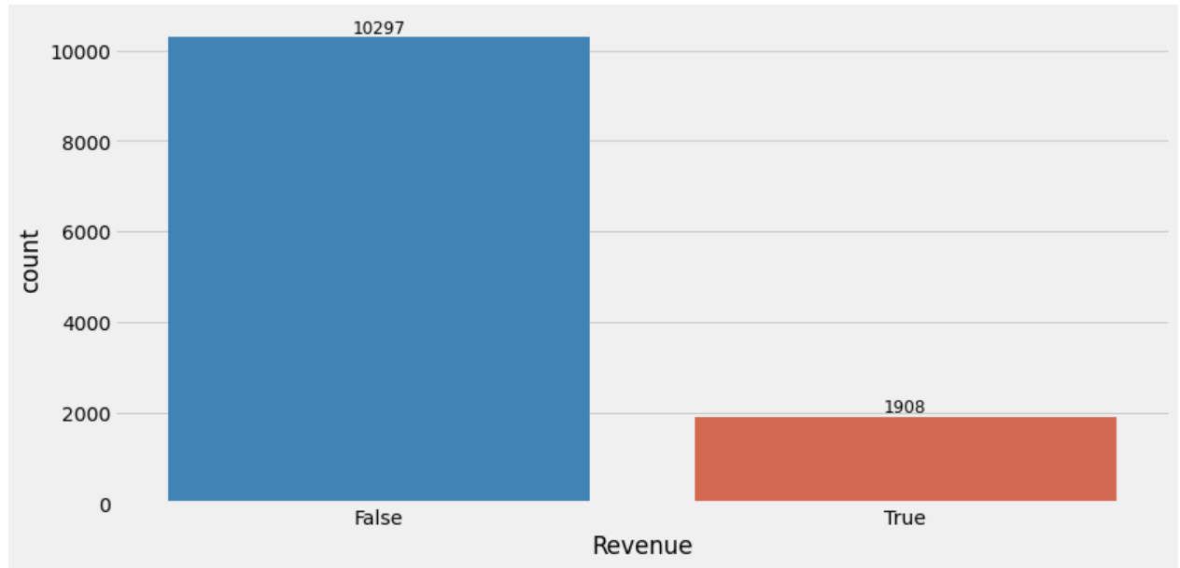
Revenue
Only 15.47% percent of customers ended up making purchase a or more.
So, the conversion rate is 15.47%
We can see that the number of entries where the customer ended up not purchasing is much higher that the number of entries where the customer ended up completing a transaction. This makes sense, as most normal online shopping ends without a purchase.

Slide 10
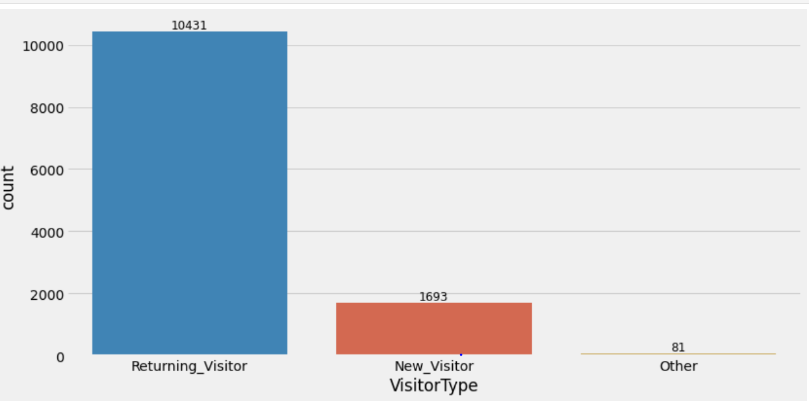
Visitors Type
85% of customers returns to site, which is a good indication. Meaning that the customers are satisfied with what they are getting.
13.74% of customers are new customers.

Slide 11
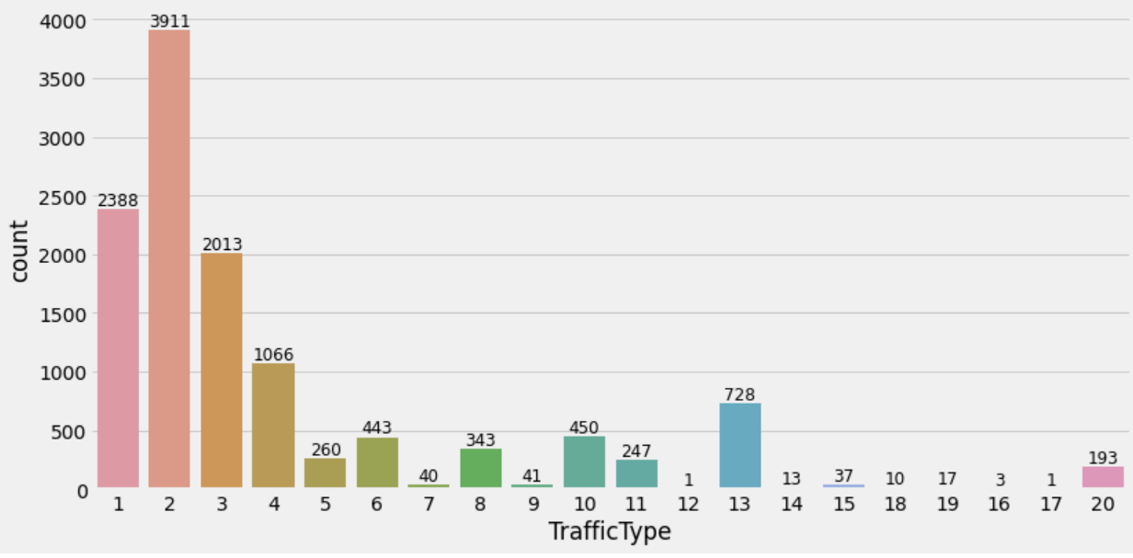
Traffic Type
The majority of visitors are coming from traffic type 2 - around 32%
The total 83% of visitors coming from 5 major traffic type 1,2,3,4, and 13

Slide 12
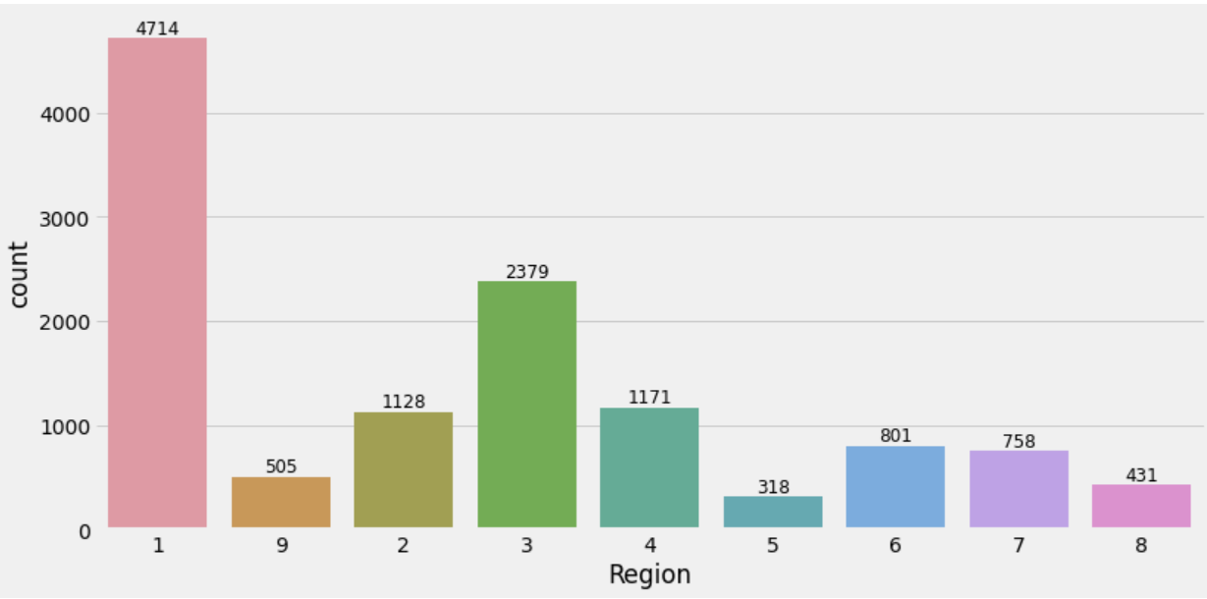
Region
Around 39% of visitors come from region one followed by 19.5% from region 3
Region 1 accounts for most sales, and region 3 the second most.
With this information, Marketing campaigns and supply chain activities can be planned in a better way.
For example, we might propose building a warehouse specifically catering to the needs of region 1 to increase delivery rates and ensure that products in the highest demand are always well stocked.

Slide 13
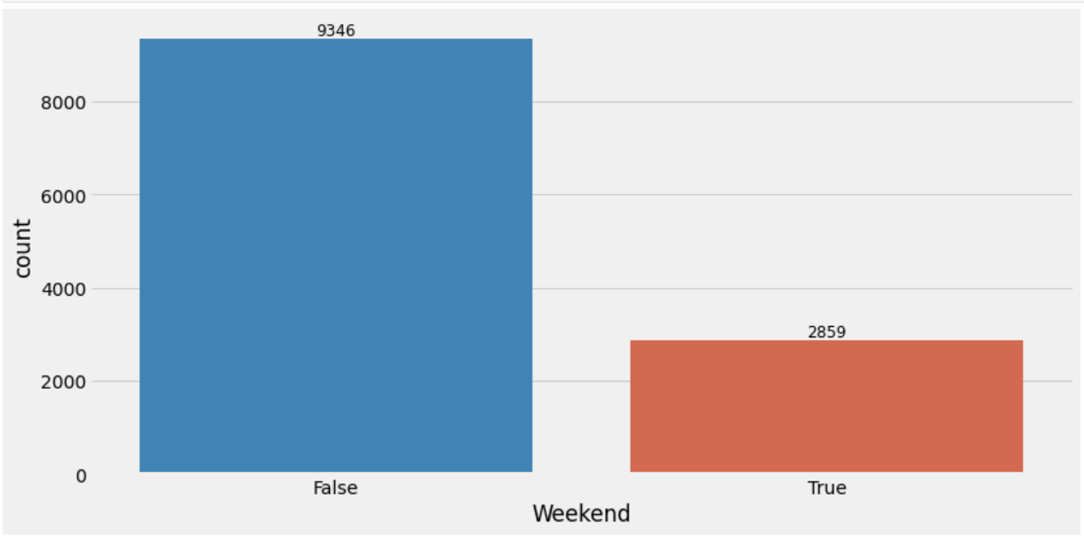
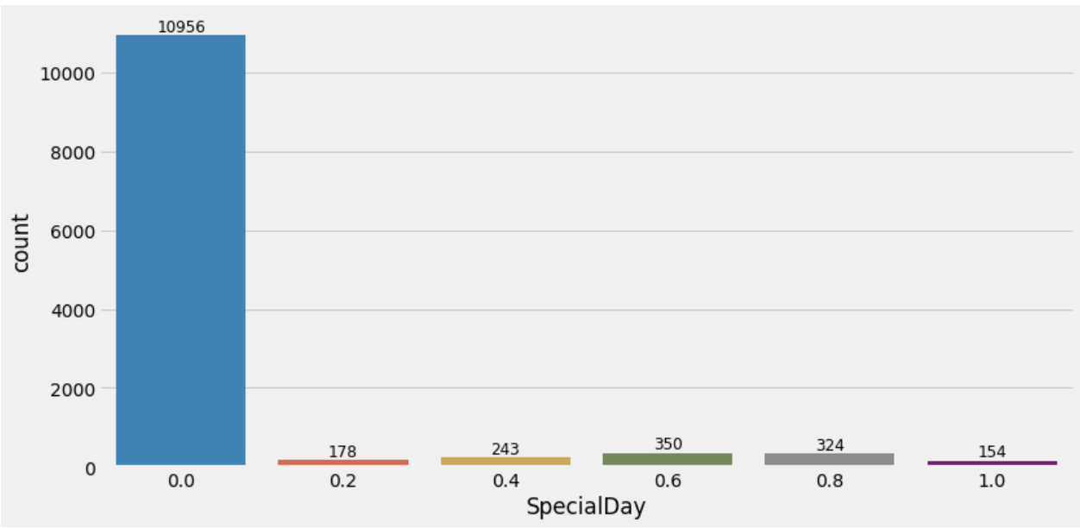
Weeks and special days
More visitors visit the site during weekdays than weekends
The special days have no impact on the number of visitors to the website.

Slide 14
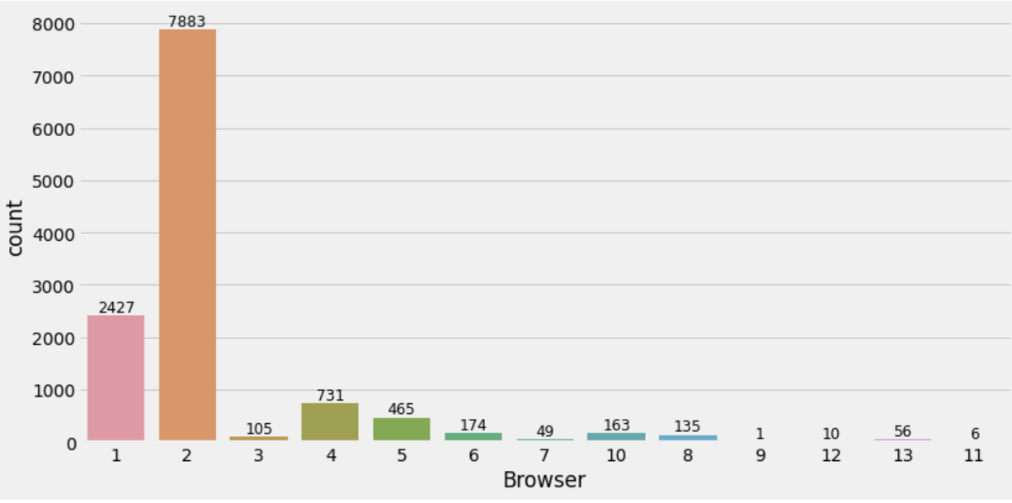
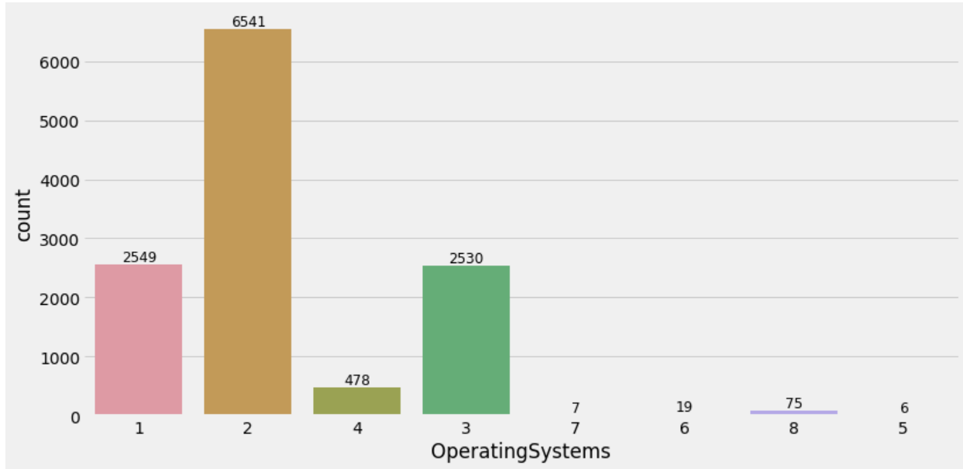
Browser and operating system
64.5% percent of visitors are coming from browser 2 followed by 20% from browser 1.
More than 50% of visitors are using operating system 2. Around 95% of visitors are coming from major three operating systems - os 2 (53.5%), os 1 (21%), os 3 (21%)

Slide 15
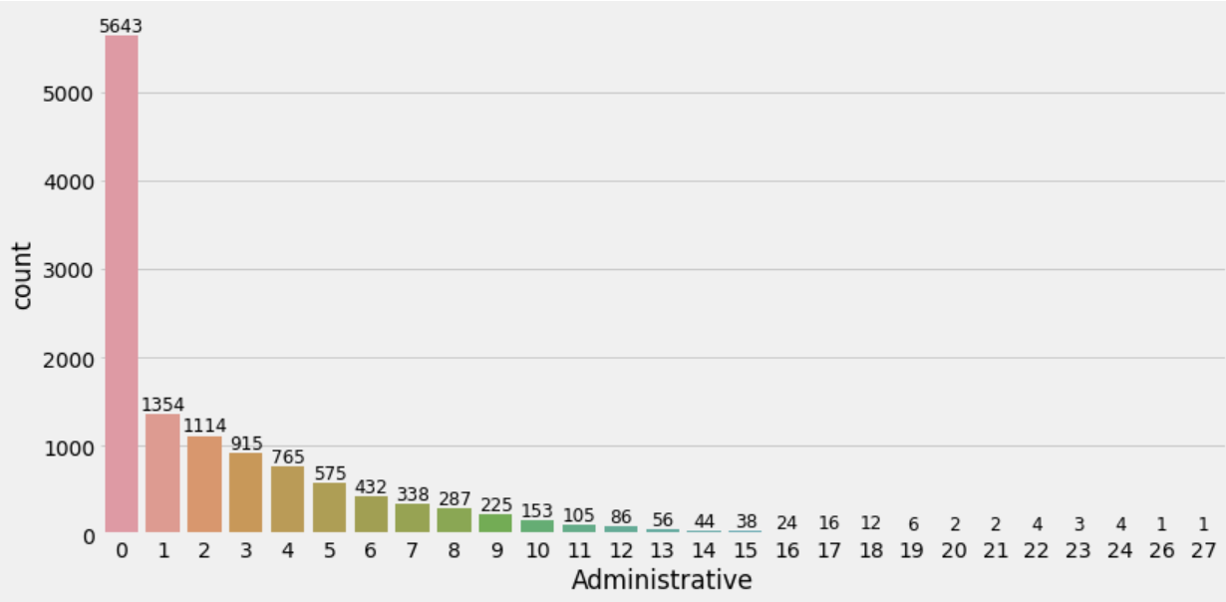
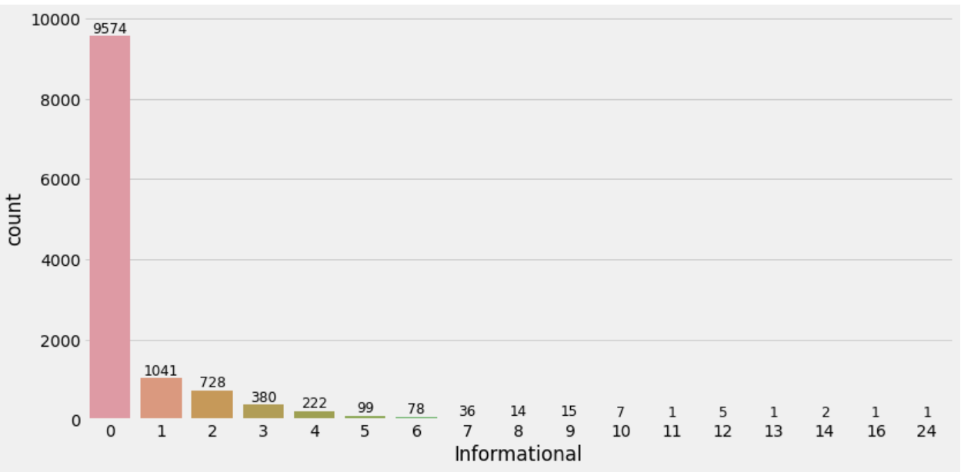
Administrative and Information
From both graphs we can conclude that users tend to visit page 0 the most often.

Slide 16
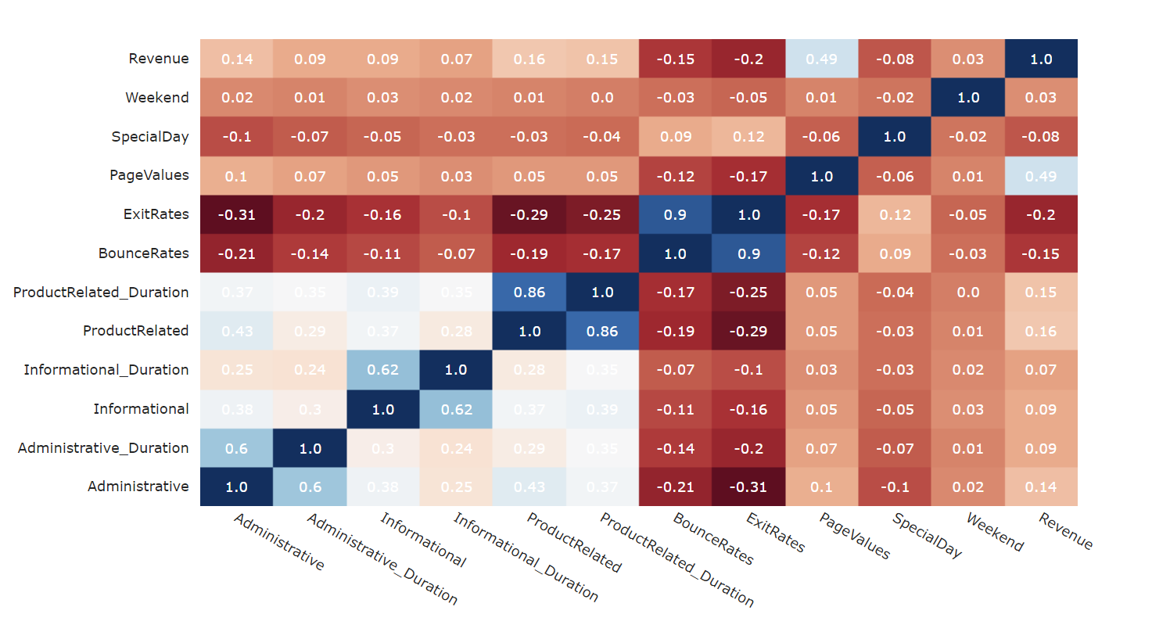
Correlation matrix
The correlation plot shows that 6 attributes have decent correlation (relative to the data) with the target Revenue:
PageValues
ExitRates
ProductRelated
ProductRelated_Duration
BounceRates
Administrative

Slide 17
Bivariate Analysis
Chi-Square test

Slide 18
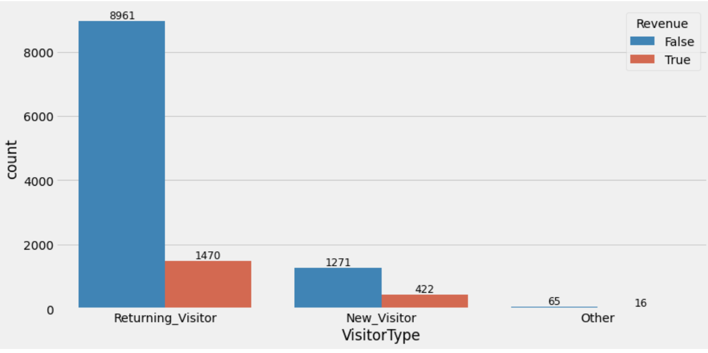
Visitors type and the revenue
More revenue conversion happens for returning customers than new customers.
The company needs to give incentives to new customers to make purchase.
P-value: 0.0000 -
It means we can **reject the null hypothesis (at 95% CI)** and conclude that
**Revenue is dependent on VisitorType.**

Slide 19
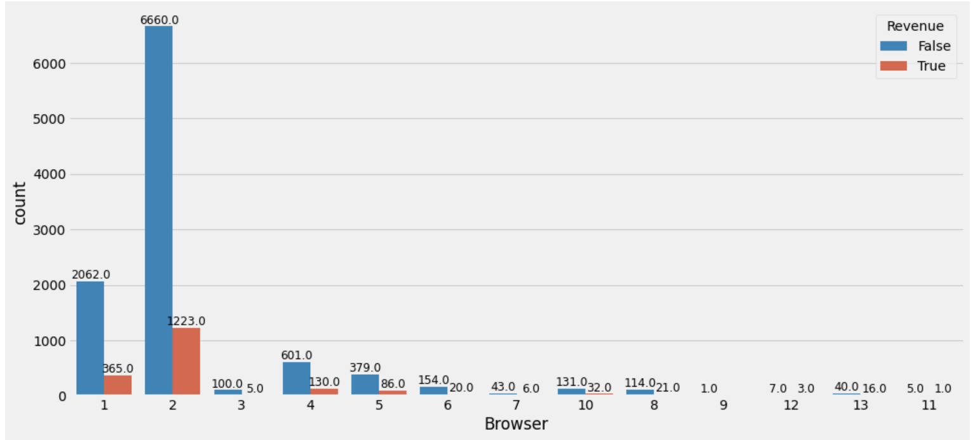
Revenue and Browser
More revenue-generating transactions have been performed from Browser 2. *
Even though Browser 1 creates a considerable number of sessions, the conversion rate is low.
P-value: 0.0038 -
It means we can **reject the null hypothesis (at 95% CI)** and conclude that
**Revenue is dependent on Browser.**

Slide 20
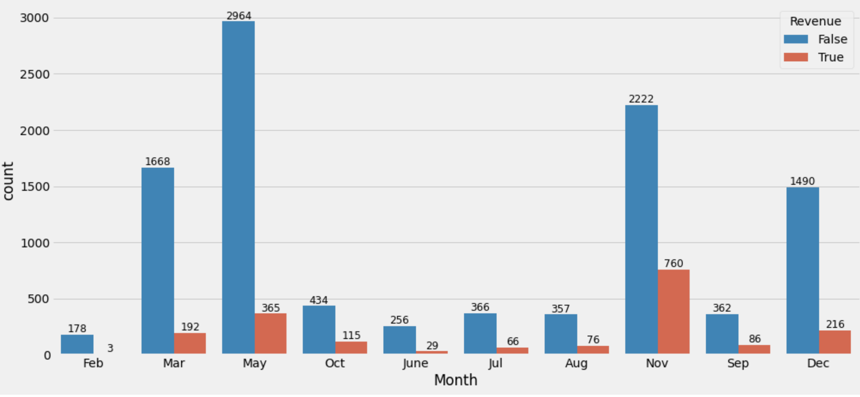
Revenue and Month
Website visitors may be high in May, but we can observe from the preceding bar plot that a greater number of purchases were made in the month of November..
P-value: 0.0038 -
It means we can **reject the null hypothesis (at 95% CI)** and conclude that
**Revenue is dependent on Month**

Slide 21
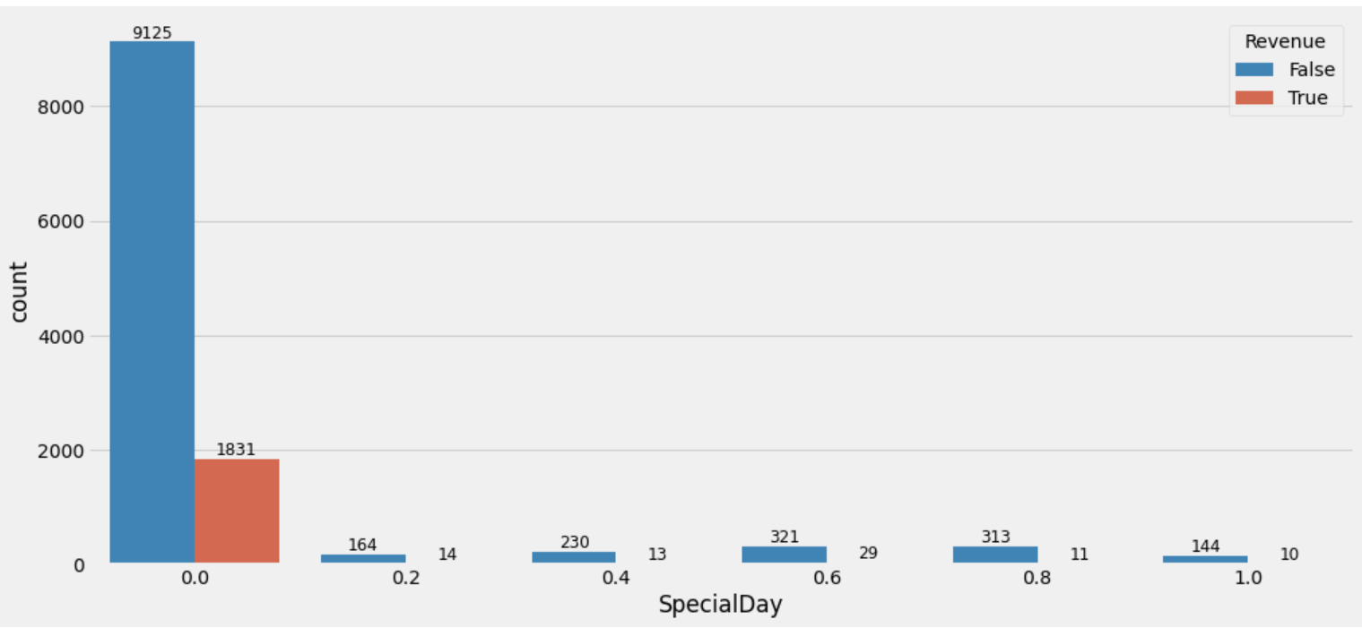
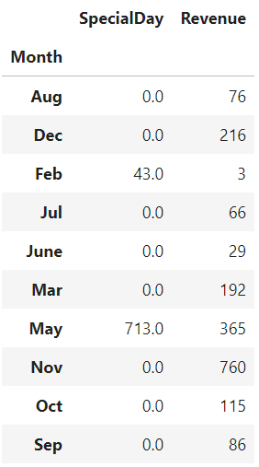
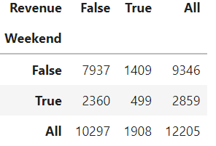
Revenue and special days
Finally, to get the pick period of purchase and visiting we analyzed the months, weeks, and special days features. The Months with most online sessions are March, May, November and December. This may be caused by the important holiday, and special days in these months like woman's day (Mar), Mother’s Day (May), black Friday, Thanksgiving (Nov), Christmas, and Happy New Year (Dec)..
P-value: 0.0038 -
It means we can **reject the null hypothesis (at 95% CI)** and conclude that
**Revenue is dependent on special days**

Slide 22
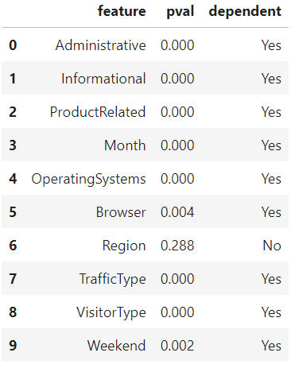
Features dependency on revenue
From chi-squared test we got that except Region all other discrete features are dependent on Revenue feature

Slide 23
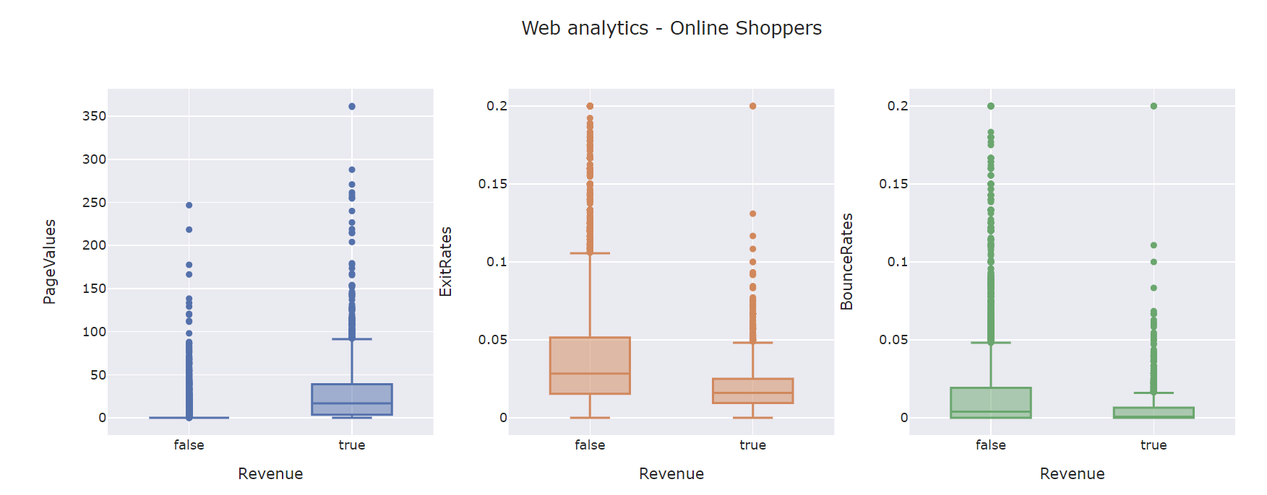
Web analytics plots
PageValues, ExitRates and BounceRates shows some difference between website visitors that purchased and those that did not

Slide 24
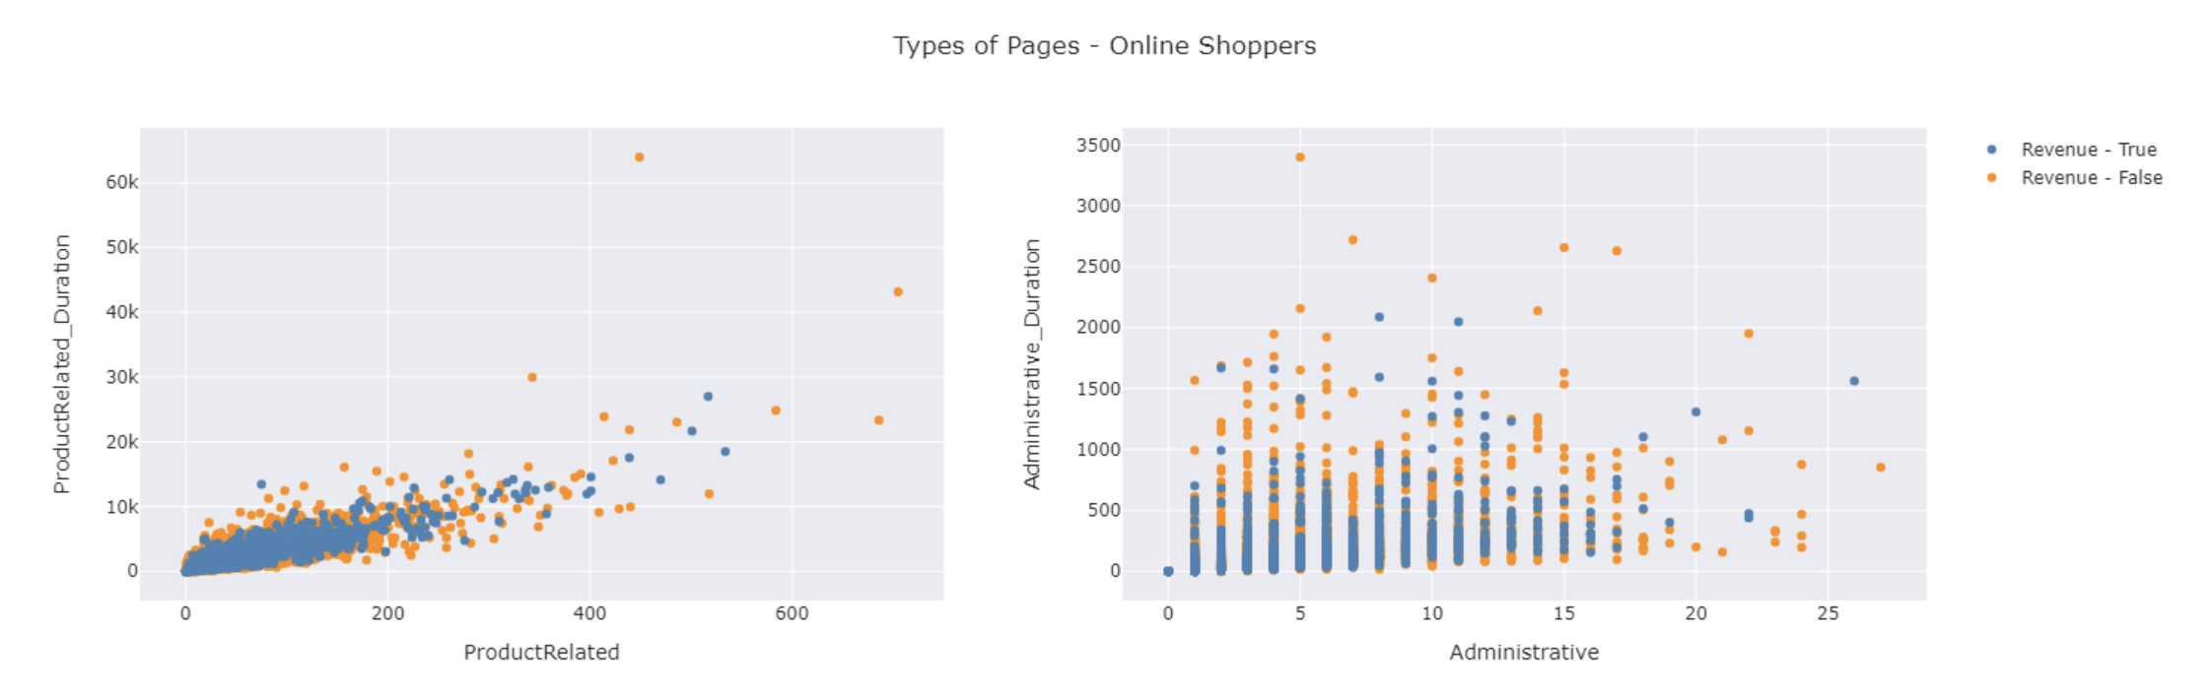
Type of Page Analysis
Product related and administrative page type attributes shows some separation between website visitors that purchased and those that did not. Pages with a high page value have a lower bounce rate. Companies should be talking with their tech team to find ways to improve the page value of the web pages.

Slide 25
Predictive models

Slide 26
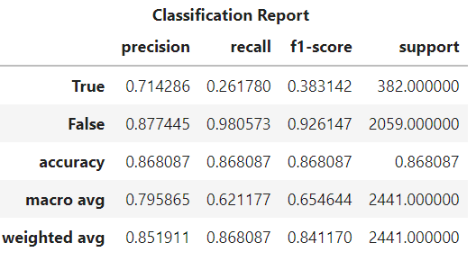
Logistic Regression Model
The weighted average f1 score of 0.84 seems great but it's not applicable as the target label is unbalanced with significantly more examples of website visits that did not result in revenue.
More reasonable metrics would be the macro average f1 score (~0.65) and roc auc score (0.62). Given the scores of the a for mentioned metrics, the baseline classifier (Logistic Regression) performance is mediocre.
Basline model ROC AUC score: 0.6211765992234323

Slide 27
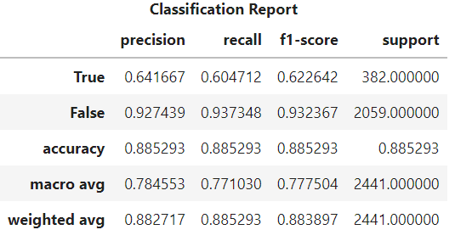
MLP Classifier Model
The Multilayer Perceptron classifier is a good starting point for modelling the shopping intentions of website visitors.
The classifier is really good at identifying negative examples (recall of ~0.93) and not that great at identifying positive examples (recall of ~0.60).
Possible improvements to the model could involve experimenting with different sampling techniques, feature engineering and different algorithms.
Multilayer Perceptron model ROC AUC score: 0.77103013458981

Slide 28
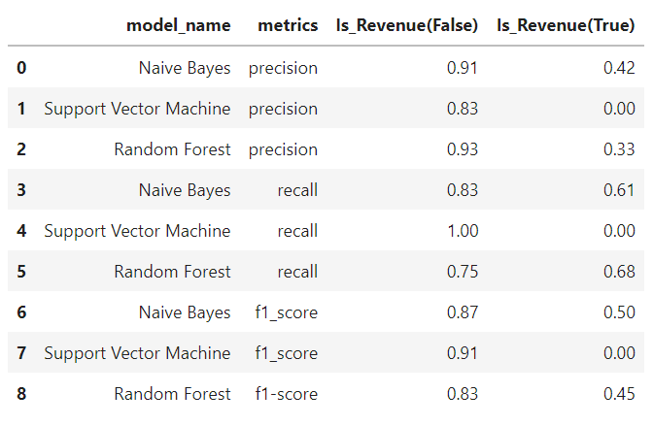
Comparison between the naïve bayes, the SVM and the random forest classifiers
From this comparison in term of accuracy ad precision the best model is the naïve bayes and from the previous experiment the best model is the multilayer perceptron was the most accurate with 0.88.
So, we can conclude that the latter is the best model to predict online shoppers’ intention compared with the other 4 models that we experimented with.

Slide 29
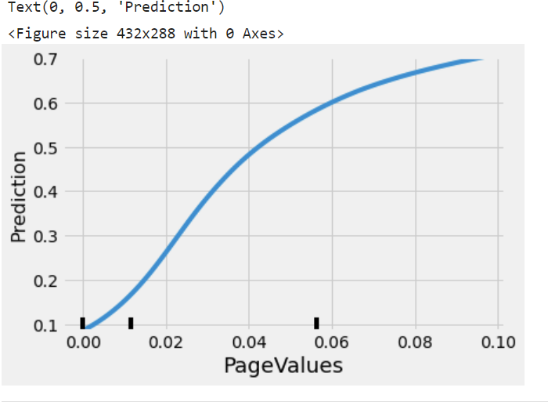
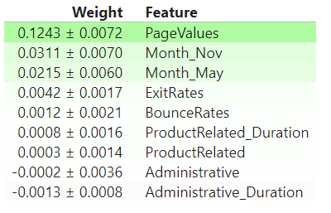
Feature selection
What are the most important features?
What feature values impact the classifier?
The plot is a useful tool for determining how different Page Values will change the prediction of the classifier. The threshold for the target label (Revenue) is at 0.50 on the y-axis. The Page Values attribute has a positive relationship with the prediction i.e., as the Page Value increases, the prediction increases toward 1 (website visitor is more likely to purchase).
The table above is the list of attributes (in order of importance) that were used to classifier.

Slide 30
THANK YOU

